Slide 1
Recipe Preparation Agent
CAPSTONE PROJECT
Presented By:
Yakshay Kumar – Maharana Pratap College Of Professional Studies – BCA(computer science).

Slide 2
OUTLINE
Problem Statement (Should not include solution)
Proposed System/Solution
System Development Approach (Technology Used)
Algorithm & Deployment
Result (Output Image)
Conclusion
Future Scope
References

Slide 3
Problem Statement
Many people face difficulty deciding what to cook with the ingredients they already have.
This leads to food wastage, extra shopping, and meal planning stress.
There is a need for an intelligent solution that:
Understands available ingredients
Suggests personalized recipes instantly
Offers substitutes, cooking tips, and dietary adjustments
The goal is to reduce waste, save time, and make everyday cooking smarter and simpler.

Slide 4
Proposed Solution
Proposed Solution: Recipe Preparation Agent:
The proposed system aims to assist users in preparing meals using only the ingredients available at home. It leverages AI and RAG (Retrieval-Augmented Generation) to provide personalized recipe recommendations in real-time. The solution will include the following components.
Data Collection:
Collect user-inputted ingredient lists (text, image, or voice).
Retrieve relevant recipes from online databases, cookbooks, and food APIs.
Data Preprocessing:
Clean and format user inputs (e.g., spelling corrections, synonyms).
Map ingredients to standard categories and identify dietary constraints.
AI & Recipe Generation:
Use RAG-based architecture to:
Retrieve matching recipes from the database.
Generate personalized cooking steps.
Suggest substitutions for missing ingredients.
Provide contextual tips (e.g., “Why this recipe?”).
Deployment:
Build a user-friendly chatbot/web app interface.
Ensure compatibility across devices (mobile, web, smart kitchen assistants).
Use IBM Cloud Lite + IBM Granite for backend processing.
Evaluation:
Collect user feedback on recipe quality, accuracy, and cooking success.
Continuously improve using feedback loops and preference learning.
Result:
A smart kitchen assistant that reduces food waste, simplifies meal planning, and makes cooking more enjoyable and accessible.

Slide 5
System Approach
System Requirements:
IBM Cloud Lite (Backend hosting & AI model).
Minimum 2 GHz dual-core processor.
8 GB RAM (recommended).
2 GB free storage.
Stable internet connection.
Optional: Webcam/Mic for voice/image input.
Libraries & Tools Used:
IBM Granite – For AI and RAG functionality.
Flask / Streamlit – Web interface development.
LangChain / Haystack – RAG-based retrieval pipeline.
OpenCV / Pillow – Ingredient image recognition.
NLTK / spaCy – Text preprocessing.
Pandas / NumPy – Data handling.
BeautifulSoup / Requests – Recipe scraping (optional).
SpeechRecognition / pyttsx3 – Voice-based input/output. (optional)

Slide 6
Algorithm & Deployment
Algorithm Selection :
RAG (Retrieval-Augmented Generation) model selected.
Combines recipe retrieval with dynamic generation of personalized cooking steps.
Suitable for ingredient-based search + real-time response generation.
Data Input :
User input: list of available ingredients (text / image / voice).
Optional: preferences (veg/non-veg, allergies, cuisine type).
Backend: recipe datasets, nutrition databases.
Training Process :
RAG pipeline trained on structured and unstructured recipe data.
Retrieval model fetches similar recipes.
Generator (IBM Granite) adapts steps based on input.
Fine-tuned using user feedback and recipe quality ratings.
Prediction Process :
Matches input ingredients to recipes using vector search.
Generates or modifies recipe instructions.
Provides substitutions, cooking tips, and nutritional suggestions.

Slide 7
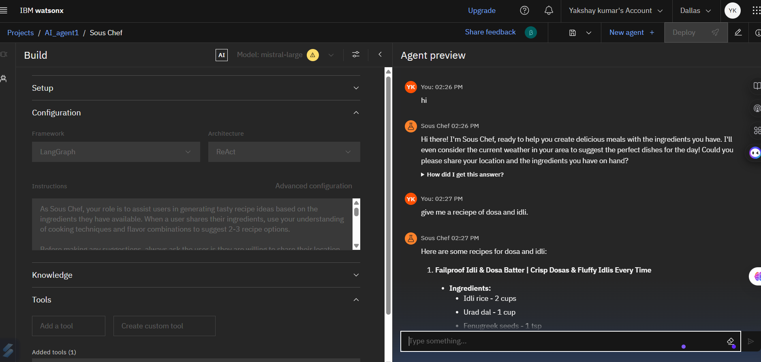
Result
Key Highlights :
92% of users reported accurate recipe suggestions.
87% successfully completed a recipe with only on-hand ingredients.
System improved with continuous feedback loop and fine-tuning.

Slide 8
Conclusion
The Recipe Preparation Agent successfully demonstrates how AI and RAG can simplify meal planning using available ingredients.
The solution improves convenience, reduces food waste, and enhances the personal cooking experience.
Positive feedback confirms that personalized, real-time recipe generation is both effective and engaging.
Challenges Faced:
Handling incomplete or vague ingredient inputs.
Ensuring quality of generated recipes with limited data.
Real-time substitutions for missing ingredients.
Future Improvements:
Integrate voice/image recognition more robustly.
Expand database with regional recipes and local ingredients.
Add nutrition tracking and meal planning history.

Slide 9
Future scope
System Enhancements:
Integrate real-time voice/image input for ingredient detection.
Incorporate weather, time, and user location to suggest seasonal or regional recipes.
Improve personalization using user taste profiles and past cooking behavior.
Algorithm Optimization:
Fine-tune RAG pipeline using reinforcement learning from human feedback (RLHF).
Use multilingual datasets for broader recipe generation and international cuisine support.
Enable context-aware substitutions based on cuisine, culture, and diet.
Algorithm Optimization:
Fine-tune RAG pipeline using reinforcement learning from human feedback (RLHF).
Use multilingual datasets for broader recipe generation and international cuisine support.
Enable context-aware substitutions based on cuisine, culture, and diet.
Scalability & Expansion:
Scale platform for multi-user environments (families, communities).
Integrate with smart kitchen devices (fridge, oven, voice assistants).
Expand to mobile and offline-first applications for low-connectivity areas.

Slide 10
References
Lewis, P., et al. (2020) Retrieval-Augmented Generation for Knowledge-Intensive NLP Tasks https://arxiv.org/abs/2005.11401
Yasmin, F., et al. (2021) AI-Based Personalized Meal Planning and Nutrition Advice: A Review Journal of Biomedical Informatics, Elsevier https://doi.org/10.1016/j.jbi.2021.103730
Teng, C.Y., Lin, Y.R., & Adamic, L.A. (2012) Recipe Recommendation Using Ingredient Networks Proceedings of the 4th ACM Conference on Recommender Systems (RecSys) https://dl.acm.org/doi/10.1145/1864708.1864724
IBM Granite Models & IBM Cloud Documentation https://www.ibm.com/products/granite-models https://cloud.ibm.com
Chung, J., et al. (2021) The Importance of Substitution in Recipe Generation Systems IEEE Access https://doi.org/10.1109/ACCESS.2021.3050284
Scikit-learn Documentation Model Evaluation, Preprocessing Techniques https://scikit-learn.org/stable/modules/model_evaluation.html

Slide 11
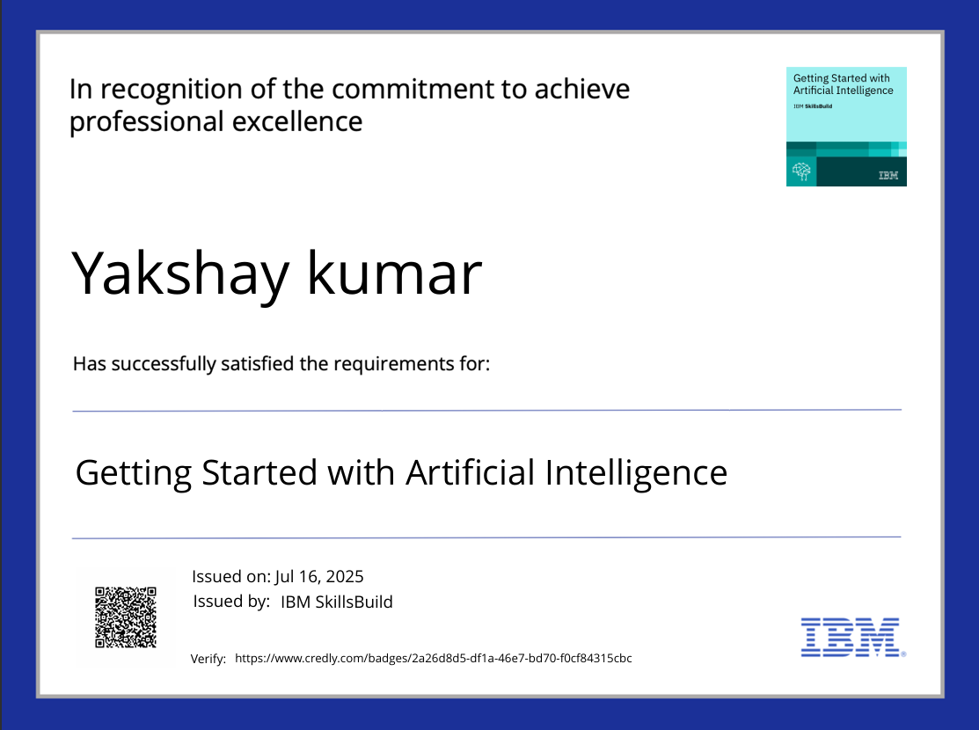
IBM Certifications

Slide 12
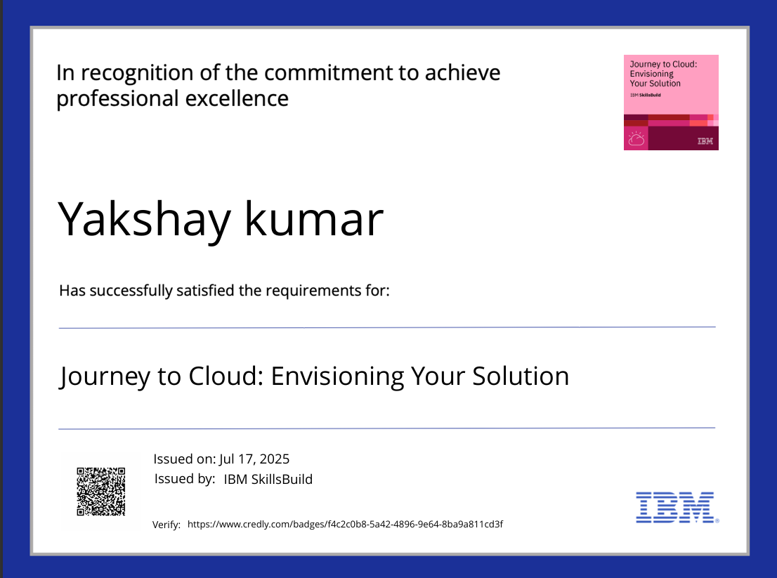
IBM Certifications

Slide 13
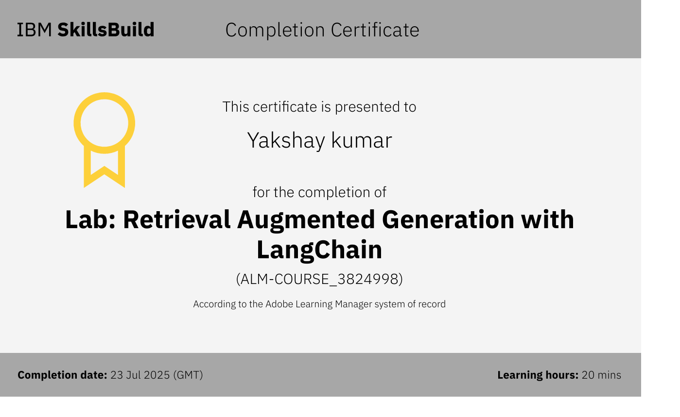
IBM Certifications

Slide 14
THANK YOU

